Slide 1
A Machine Learning Model to Predict Credit Card Fraud Transactions
Erin Amoueyan
April 2023

Slide 2
THE PROBLEM
Credit card fraud transactions pose a serious problem for both credit card companies and their customers.
Fraudulent activity can result in significant financial losses and damage to the company's reputation.

Slide 3
THE SOLUTION
Implementing effective fraud detection and prevention strategies, such as machine learning algorithms to mitigate the risk of credit card fraud and protect both the company and its customers.

Slide 4
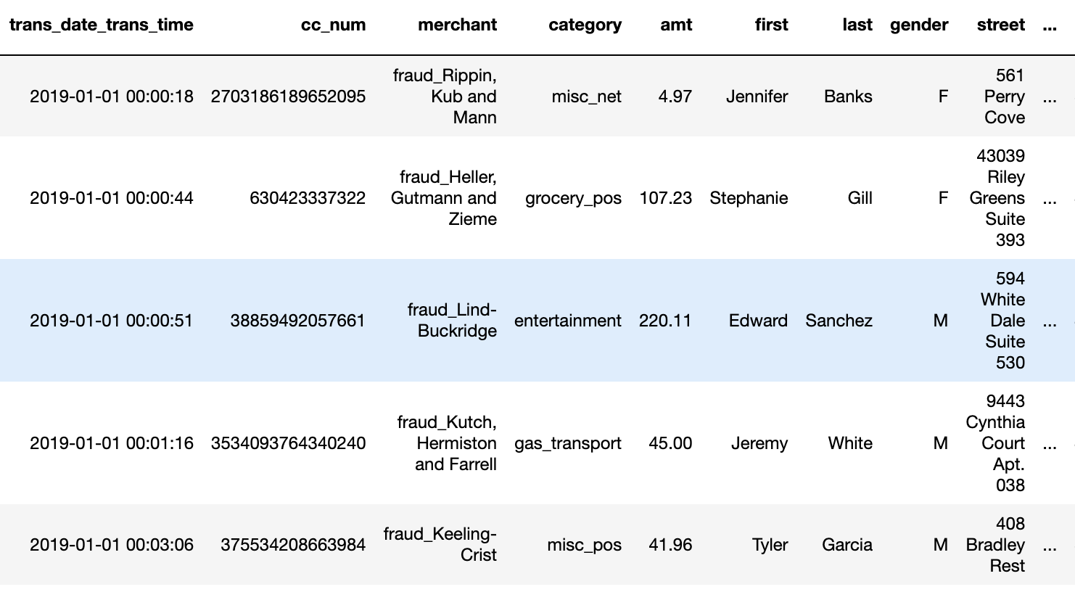
DATA
23 Columns
1,296,675 Rows
Data Source: https://www.kaggle.com/datasets/kartik2112/fraud-detection

Slide 5
DATA WRANGLING
Data duration: 1/1/2019 - 12/31/2020
Total transactions= 1,296,675
Fraud transactions= 7,506
Fraud Percentage= 0.58%
Checked for missing value
Checked for duplicate values
Target variable= is_fraud

Slide 6
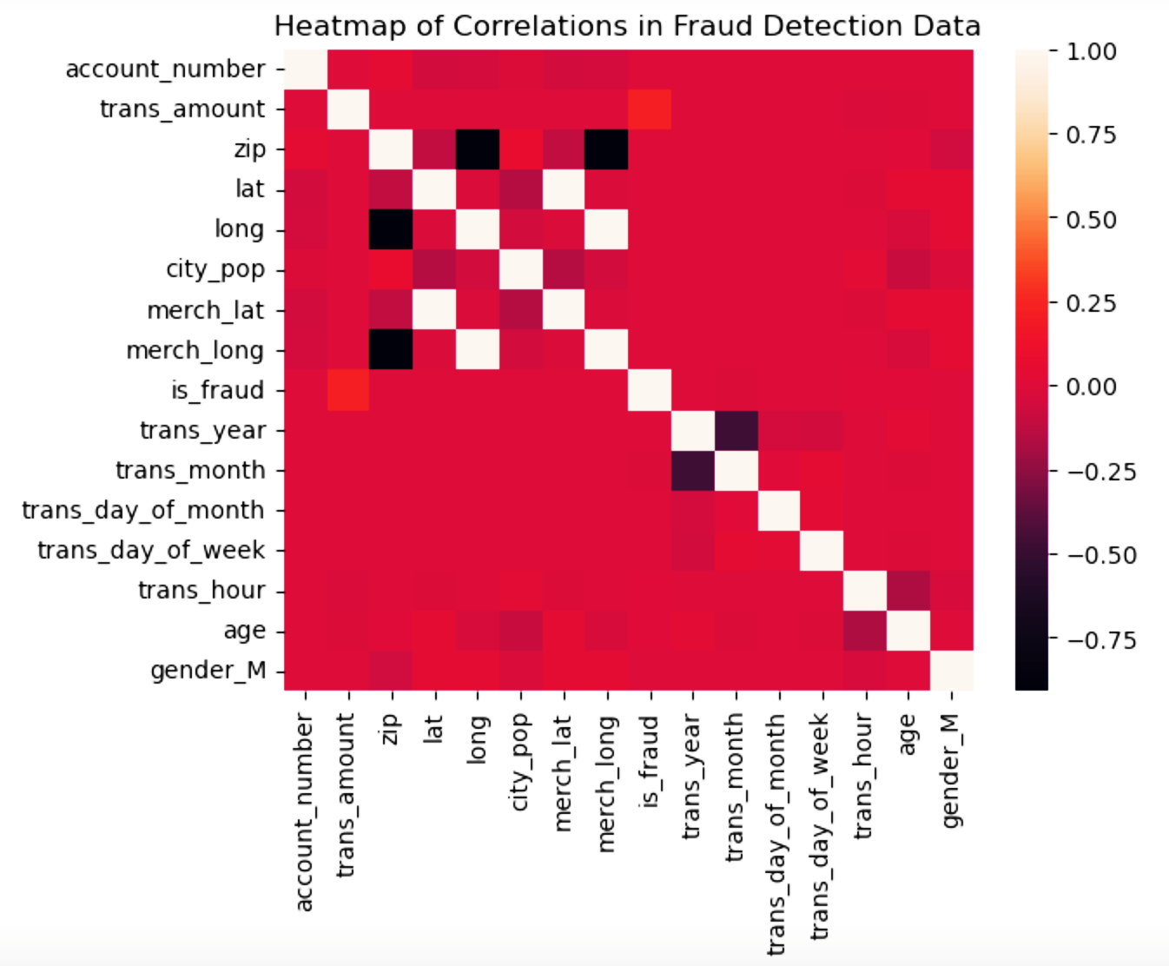
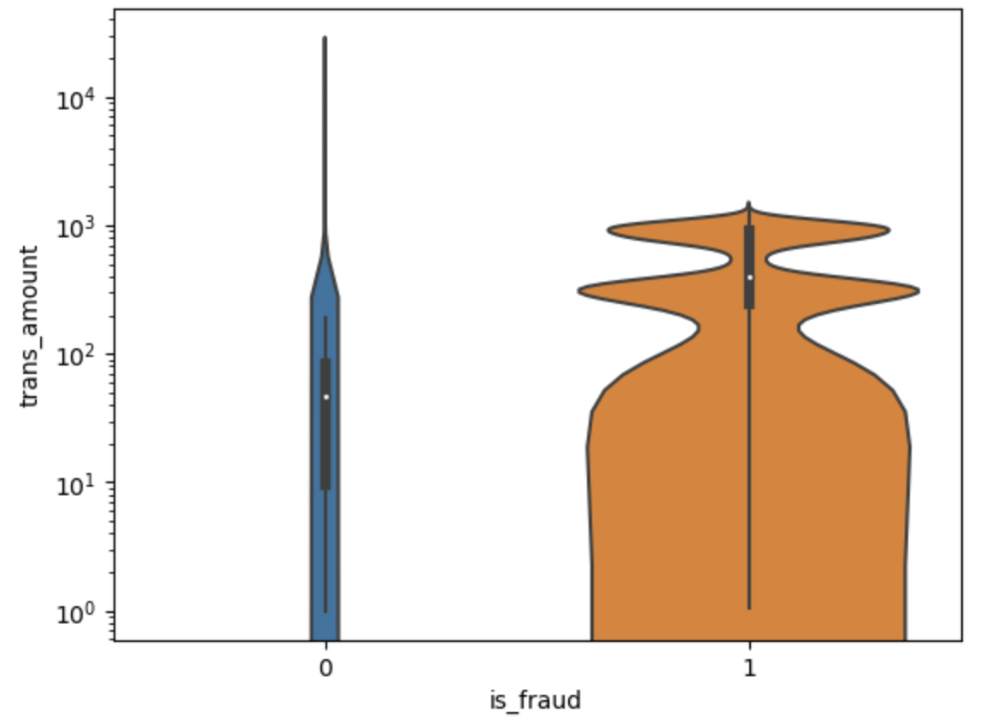
EXPLORATORY DATA ANALYSIS
Fraudulent activity may be more likely to involve high-value transactions
Highest correlation

Slide 7
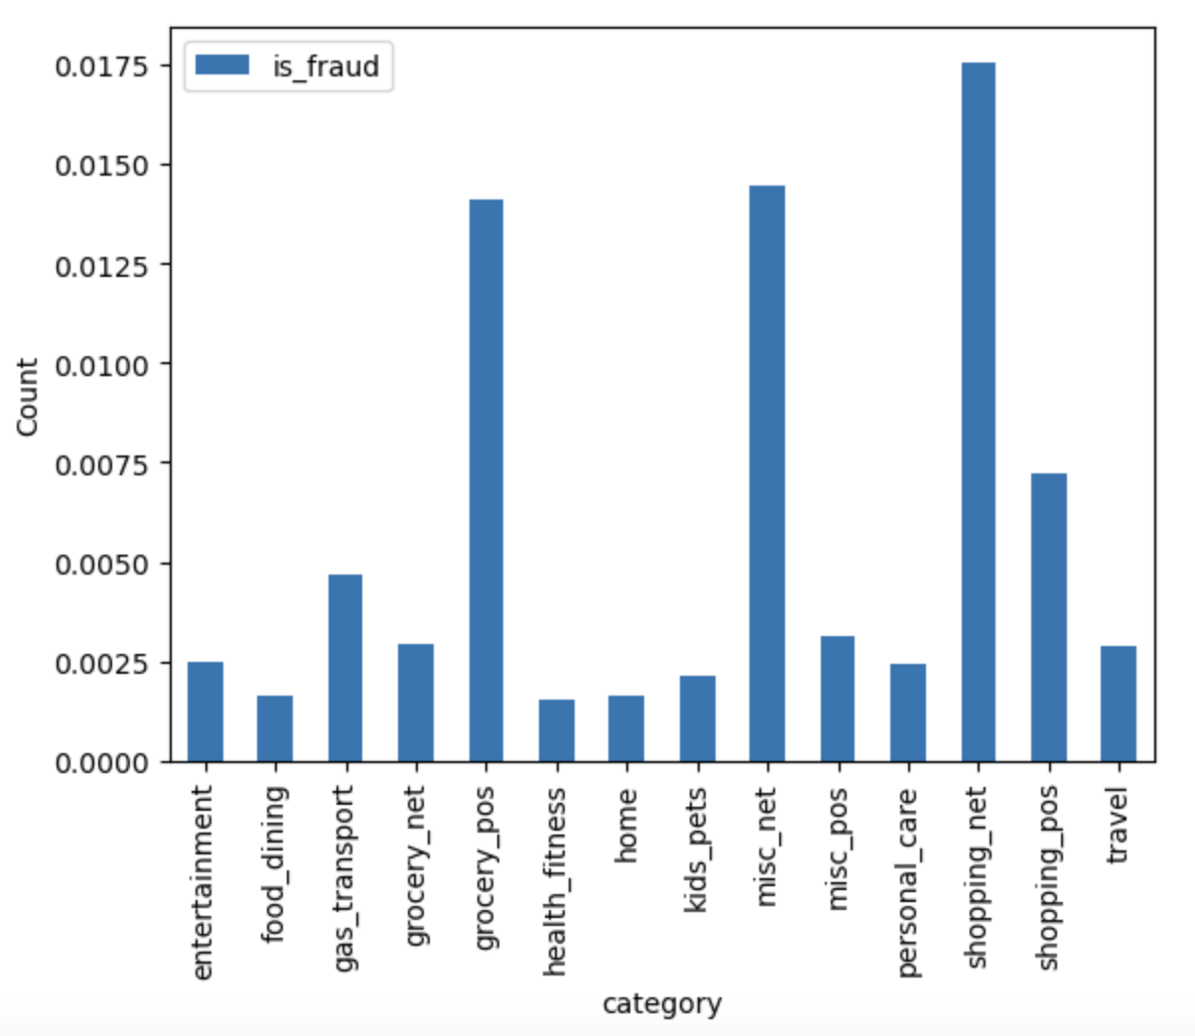
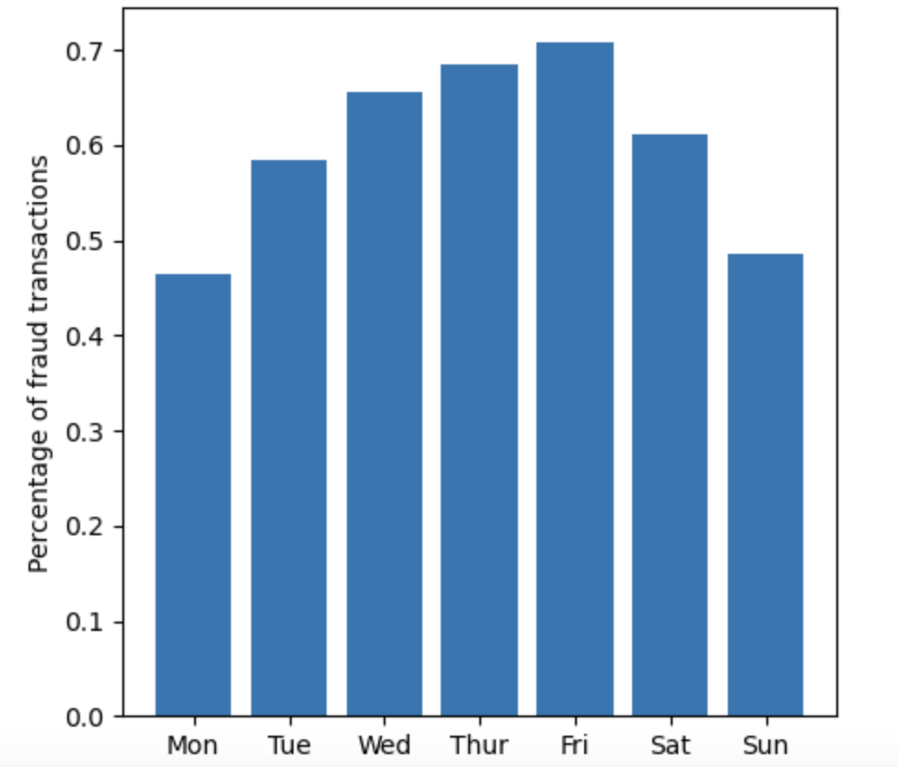
EXPLORATORY DATA ANALYSIS
Top 3 fraud transaction categories
Fraud transactions by day of week

Slide 8
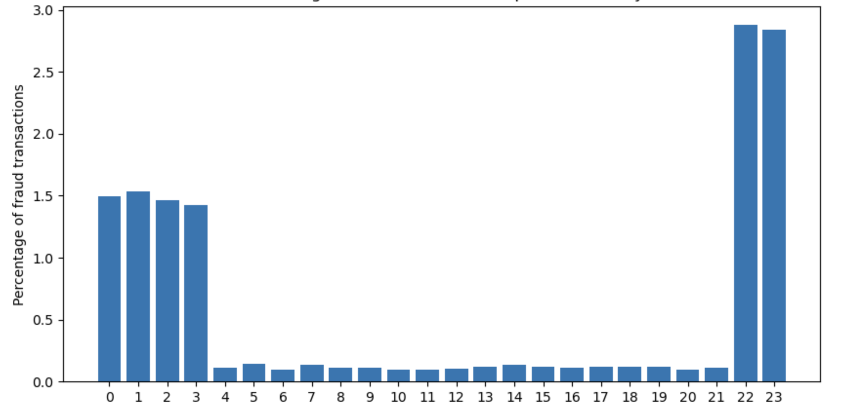
EXPLORATORY DATA ANALYSIS
Fraud transactions by hour of the day

Slide 9
MODEL SELECTION
EVALUATION METRICS
Decision Tree Classifier
Random Forest Classifier
Gradient Boosting
Hist Gradient Boosting
Adaboost Classifier
Naive Bayes
K Nearest Neighbor
Recall Score
F1 Score
Precision
Accuracy

Slide 10
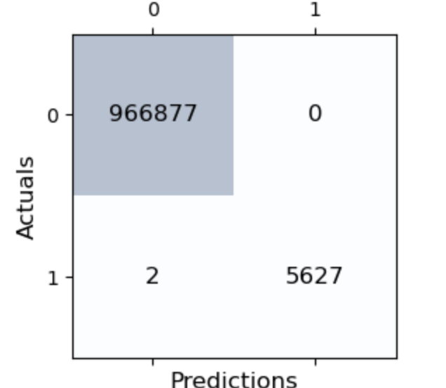
BEST PERFORMED MODEL
Random Forest Classifier
Accuracy: 0.999
Balanced accuracy: 0.999
Precision score: 1.0
Recall score: 0.999
F1 score: 0.999
Confusion matrix on Train data

Slide 11
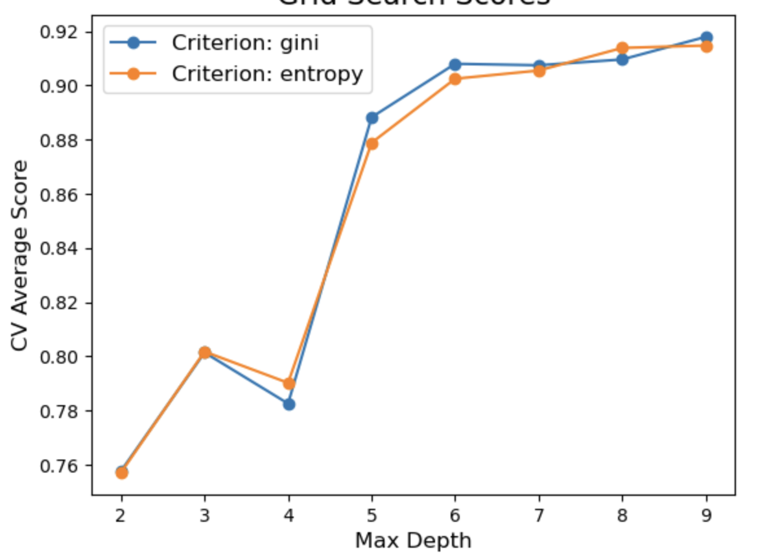
HYPERPARAMETER TUNING
Grid Search Cross Validation
max_depth : np.arange(2, 10)
Criterion : ['gini', 'entropy']
class_weight : ['balanced']
Average recall score of hyperparameter tuning

Slide 12
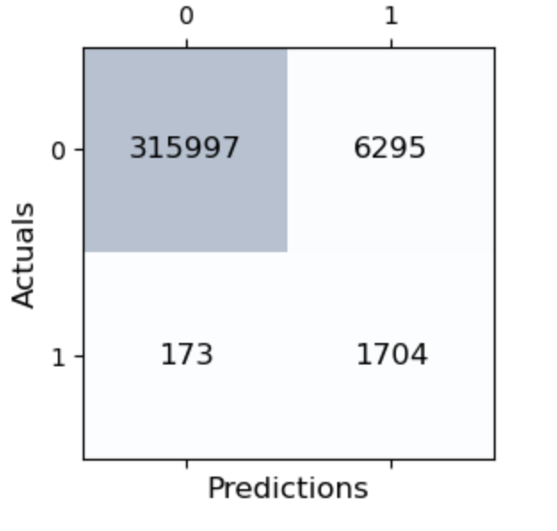
BEST TUNED MODEL
Random Forest Classifier
Max_depth=9
Criterion= gini
Accuracy: 0.980
Balanced accuracy: 0.944
Precision score: 0.213
Recall score: 0.907
F1 score: 0.345
Confusion matrix on Test data

Slide 13
Takeaways
Random Forest Classifier was the best model with below hyperparameters:
max_depth=9
criterion= gini
class_weight=balanced
Model was able to predict 90% of the fraud transactions with a relatively low false positive rate of 1.9%
Only 1.9% of legitimate transactions were mistakenly classified as fraud
Overall, the model had an impressive accuracy rate of 98%.

Slide 14
FUTURE RESEARCH
Incorporate additional features, e.g.:
time difference between the transactions and the distance difference
the IP address of the device used to make the transaction
the type of card used
Do more feature engineering such as principal component analysis
Evaluate other machine learning models such as neural networks

Slide 15
THANK YOU!

